Slide 1


Material Analysis: Thermal Gap Filler
Jean Kim, Advanced Polymeric Materials Branch Intern
Witold Fuchs, Ph.D Advanced Polymeric Materials Branch, M&P Technical Lead
Notes:
“Thermal Decomposition analysis of AEPS soft goods”

Slide 2
Bottom-line up front (BLUF)
Objective: Identify the material composition of Thermal Gap Filler
Instruments: FTIR, TGA, Outgassing
Conclusion: The binder material is most likely polyester

Slide 3
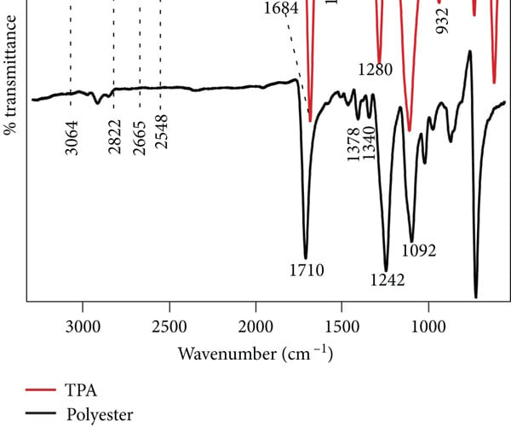
Fourier Transform Infrared spectroscopy (FTIR) Results
Symmetrical C-H Stretching (CH2)
At around ~2850 cm-1
Asymmetrical C-H Stretching (CH3)
At around ~2920 cm-1
Comparing to known spectra of polymer: The associated peak at around ~1750 cm-1at ester position, indicates C=O bond (Carbonyl)
Shamsun Nahar, Sultana & Rahaman, Md Samsur & Samadder, Rajib & Rahaman, Faisal S & Chadni, R. & Khan, Mubarak. (2022). A Modified Hydrolysis Method of Decolorizing Reactive-Dyed Polycotton Waste Fabric and Extraction of Terephthalic Acid: A Perspective to Reduce Textile Solid Waste.
Notes:
FTIR Functional Group Database Table with Search – InstaNANO

Slide 4
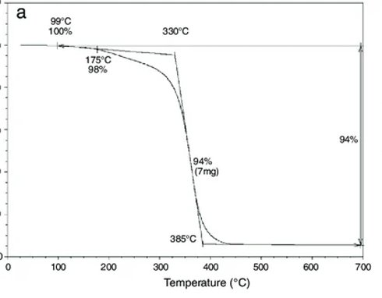
Thermogravimetric Analysis (TGA) Results
Ferreira, Marcos Vinícius & Neves, Anna & Oliveira, Caroline & Perissé Duarte Lopes, Felipe & Margem, Frederico & Vieira, Carlos Maurício & Monteiro, Sergio. (2017). Thermogravimetric characterization of polyester matrix composites reinforced with eucalyptus fibers.
The TGA result shows similar trend to neat polyester
Notes:
FTIR Functional Group Database Table with Search – InstaNANO

Slide 5
Summary
FTIR results show that the material is organic with C-H and C=O bonding. By comparing the positions of distinct peaks against known spectra, the material contains polyester-based filler.
TGA results further confirms the typical behavior of polyester.
The material is most likely contains polyester-based filler

